Slide 1
Machine Learning
AIML CZG565
M5 : Decision Tree Classifier
Course Faculty of M.Tech Cluster
BITS – CSIS - WILP

Slide 2

Machine Learning
Disclaimer and Acknowledgement
These content of modules & context under topics are planned by the course owner Dr. Sugata, with grateful acknowledgement to many others who made their course materials freely available online
We here by acknowledge all the contributors for their material and inputs.
We have provided source information wherever necessary
Students are requested to refer to the textbook w.r.t detailed content of the presentation deck shared over canvas
We have reduced the slides from canvas and modified the content flow to suit the requirements of the course and for ease of class presentation
Slide Source / Preparation / Review:
From BITS Pilani WILP: Prof.Sugata, Prof.Chetana, Prof.Rajavadhana, Prof.Monali, Prof.Anita, Prof.Sangeetha, Prof.Swarna, Prof.Srinath
External: CS109 and CS229 Stanford lecture notes, Dr.Andrew NG and many others who made their course materials freely available online

Slide 3

Course Plan
M1 | Introduction
M2 | Machine learning Workflow
M3 | Linear Models for Regression
M4 | Linear Models for Classification
M5 | Decision Tree
M6 | Instance Based Learning
M7 | Support Vector Machine
M8 | Bayesian Learning
M9 | Ensemble Learning
M10 | Unsupervised Learning
M11 | Machine Learning Model Evaluation/Comparison

Slide 4
Agenda
Information Theory
Entropy Based Decision Tree Construction
Avoiding Overfitting
Minimum Description Length
  Handling Continuous valued attributes

Slide 5
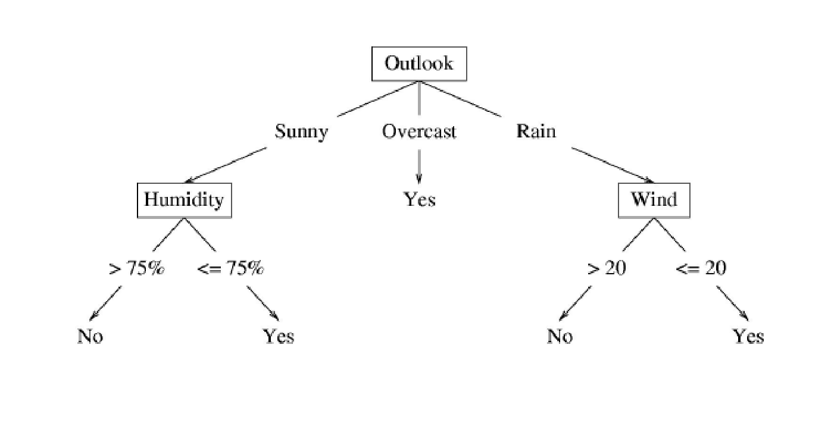
Decision Trees – Dealing with Continuous Values

Slide 6
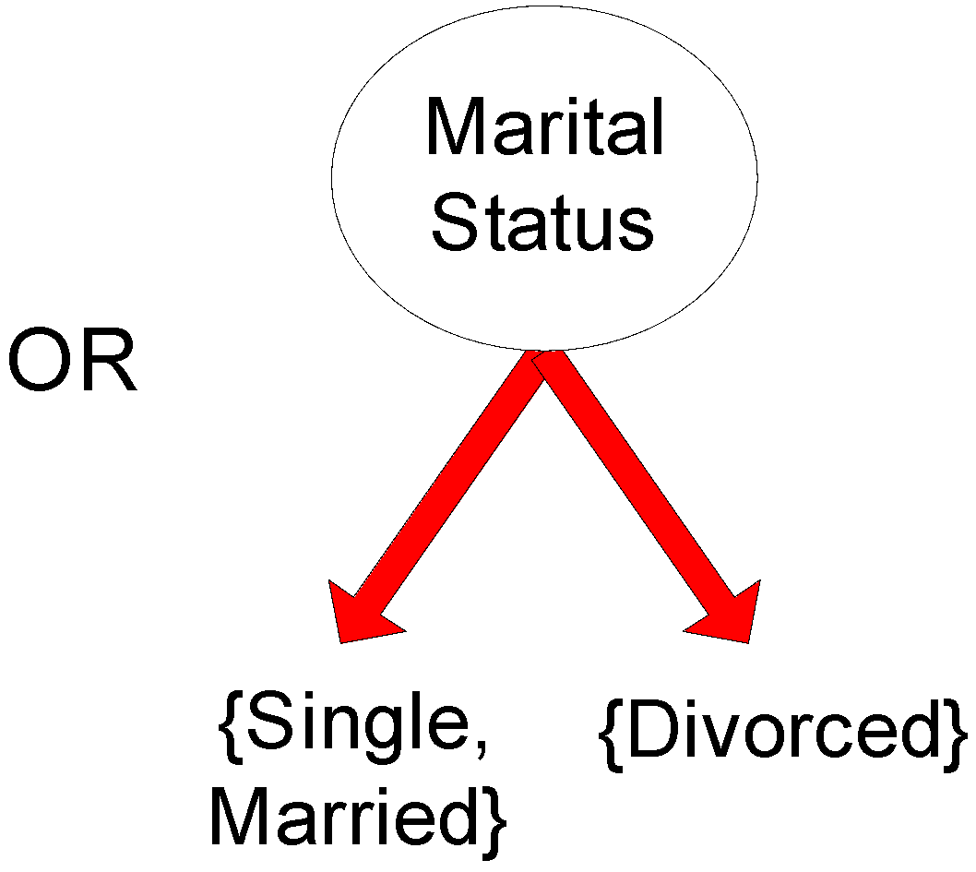
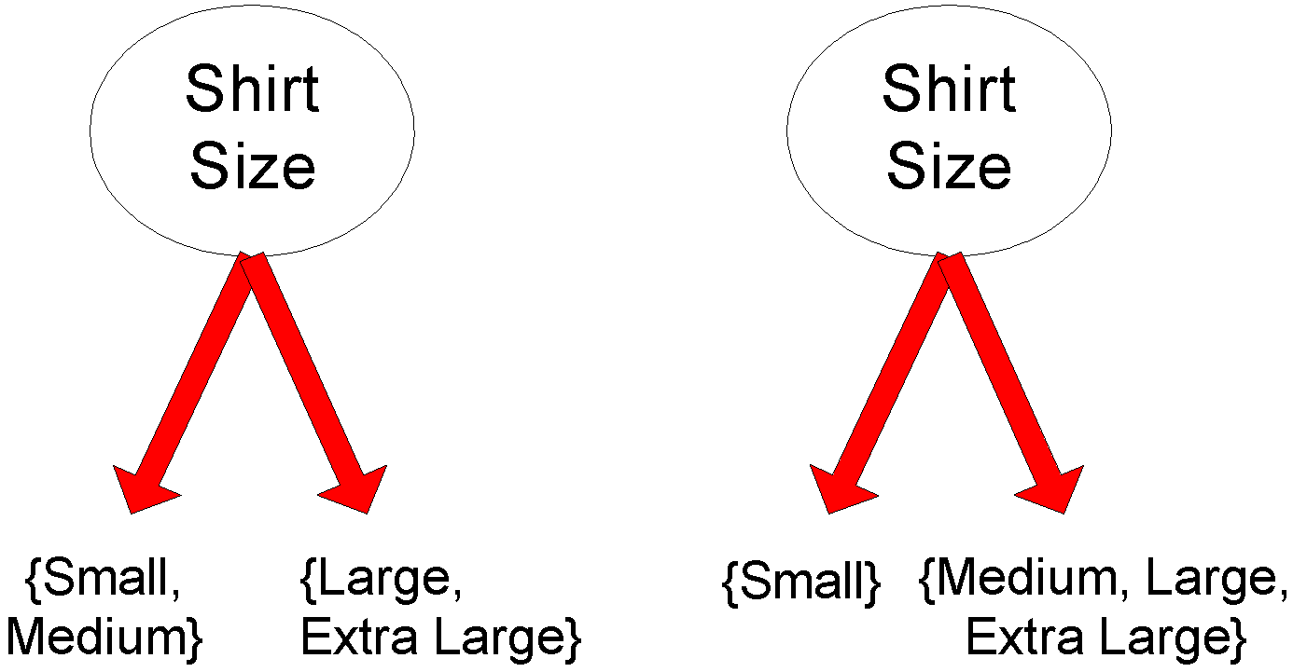
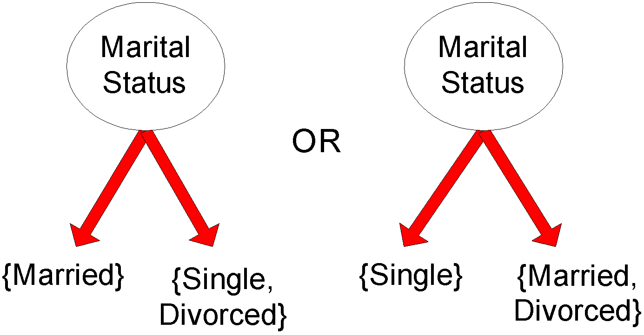
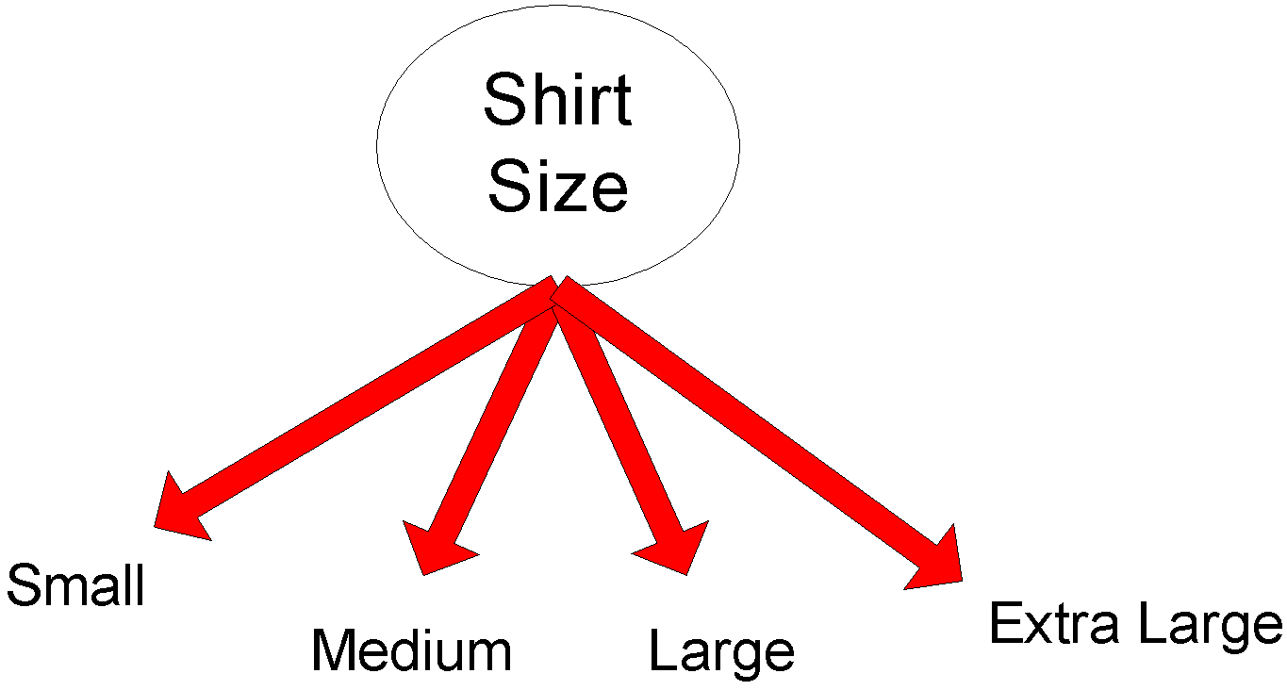
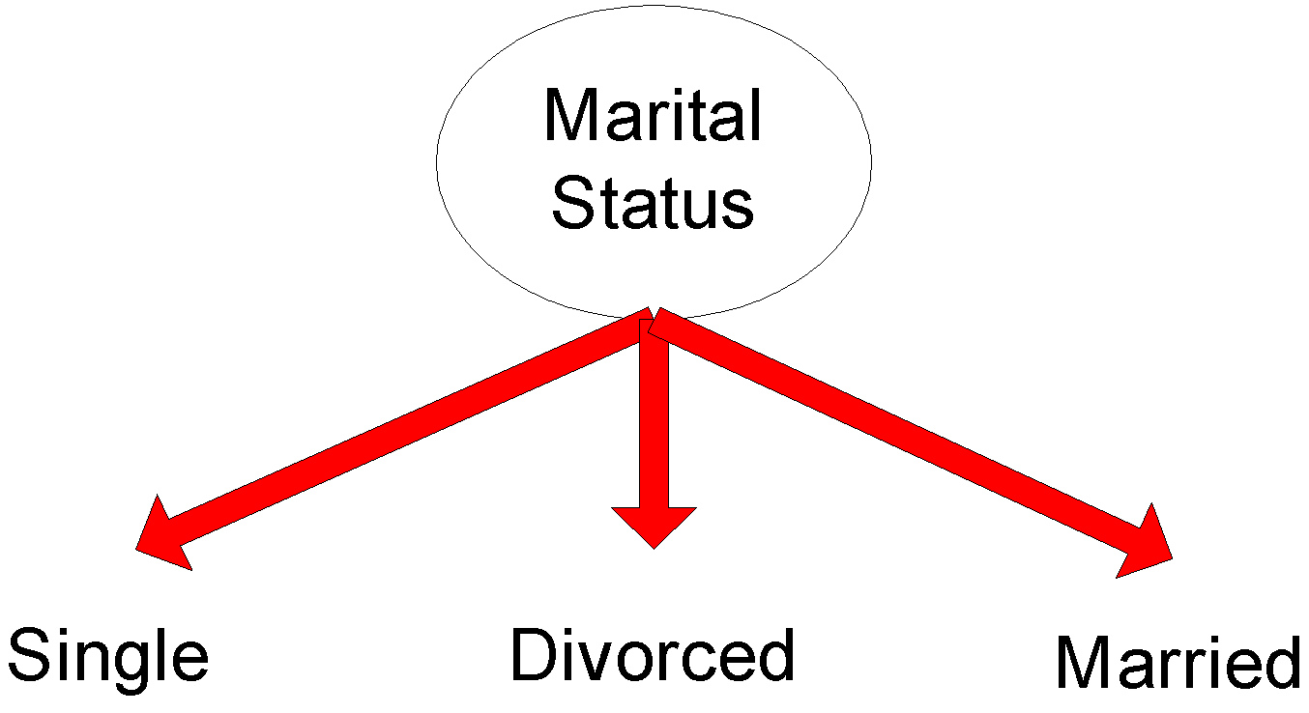
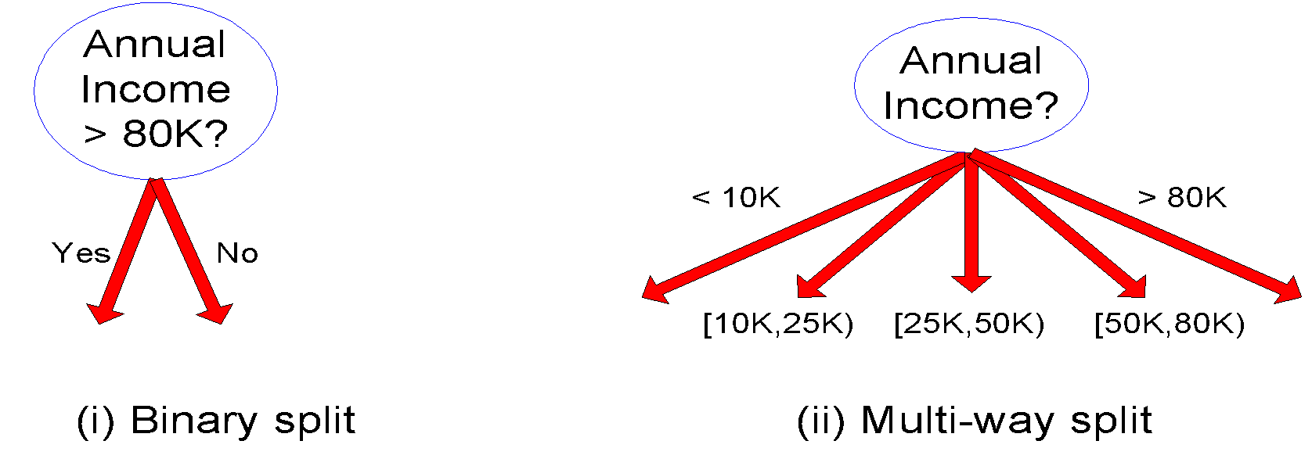
Summary
Sample splits of Different Attribute Type

Slide 7
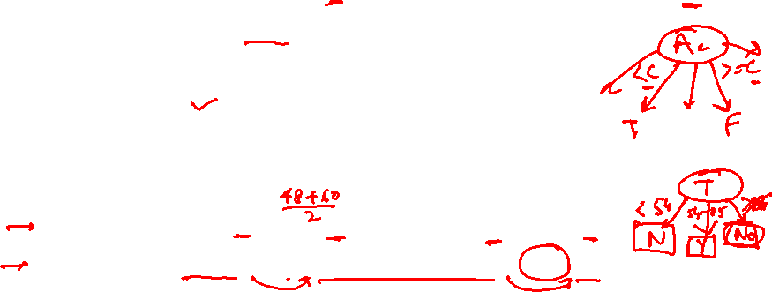
Decision Trees – Dealing with Continuous Values – Problem Type 5
Given a continuous-valued attribute A, dynamically create a new attribute A_{c}
A_{c} = True if A < c, False otherwise
How to determine threshold value c ?
Way 1: Multi-way Split
Example. Temperature in the PlayTennis example
  Sort the examples according to Temperature
  Temperature 40 48 | 60 72 80 | 90
  PlayTennis No No 54 Yes Yes Yes 85 No
  Determine candidate thresholds by averaging consecutive values where there is a change in classification: (48+60)/2=54 and (80+90)/2=85

Slide 8
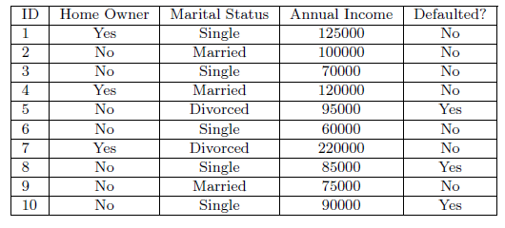
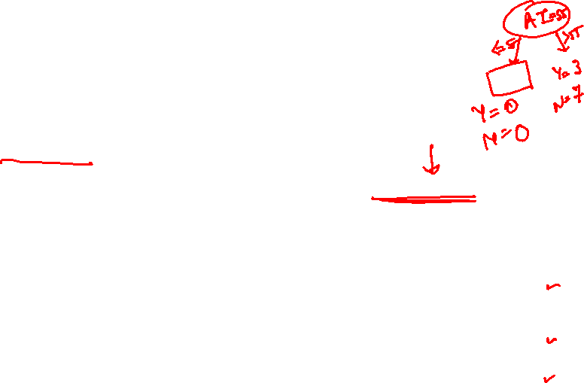
Decision Trees – Dealing with Continuous Values
Given a continuous-valued attribute A, dynamically create a new attribute A_{c}
A_{c} = True if A < c, False otherwise
How to determine threshold value c ?
Way 2: Binary Splits
Example. Annual Income
  Sort the examples according to Annual Income
  Linearly scan all possible threshold, to determine best split point where the impurity is the least

Slide 9
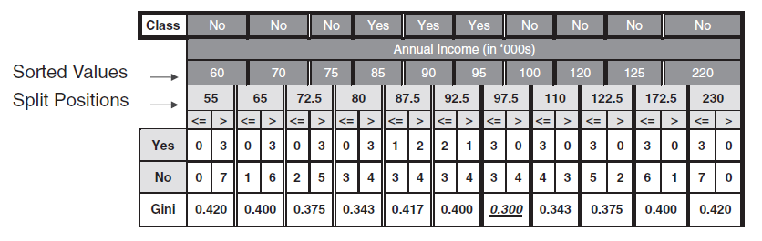
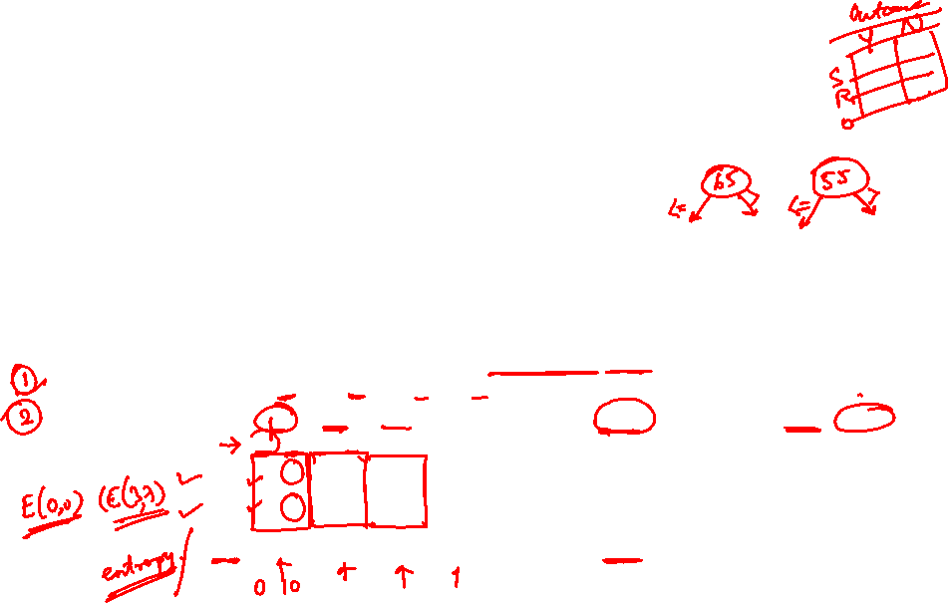
Decision Trees – Dealing with Continuous Values – Problem Type 6
Given a continuous-valued attribute A, dynamically create a new attribute A_{c}
A_{c} = True if A < c, False otherwise
How to determine threshold value c ?
Way 2: Binary Splits
Example. Annual Income

Slide 10
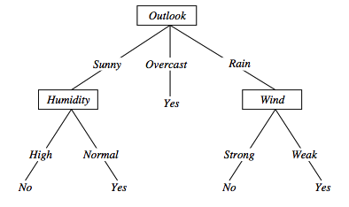
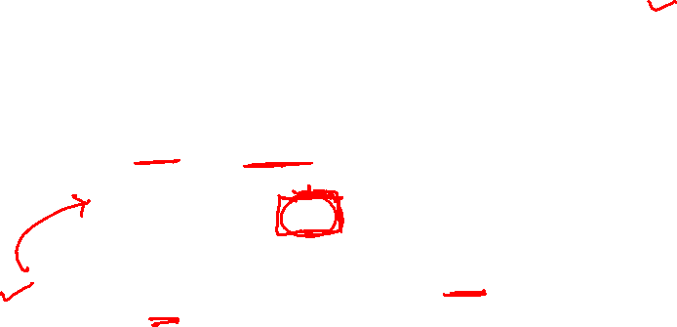
Overfitting in decision trees
〈Outlook=Sunny, Temp=Hot, Humidity=Normal, Wind=Strong, PlayTennis=No 〉
New noisy example causes splitting of second leaf node.
Notes:
The example shows that noise can lead to overfitting.
Overfitting without noise is also possible, especially when classifcation decision on the leafs are based on few examples. Uniform classification may be a coincidence.
This is a potential cause of overfitting.
Overfitting is a significant problem for DT, reducing the accuracy to 10-25% on many problems.

Slide 11
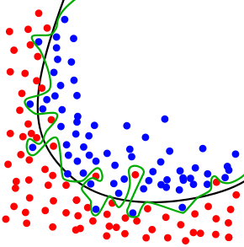
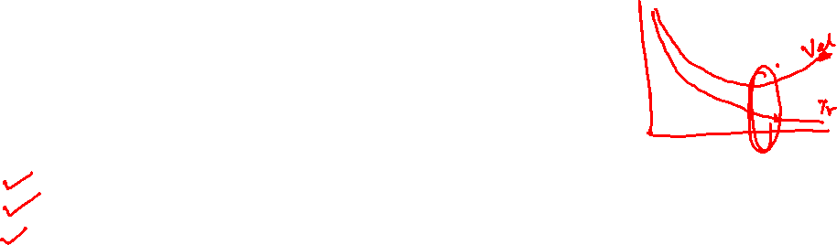
Overfitting and Tree Pruning
Overfitting: An induced tree may overfit the training data
  Too many branches, may reflect anomalies due to noise or outliers in the training data
  Poor accuracy for unseen samples
Approaches to tackle:
Pruning
Constraint on the depth of tree
Constraint on the minimum nodes allowed at leaf

Slide 12
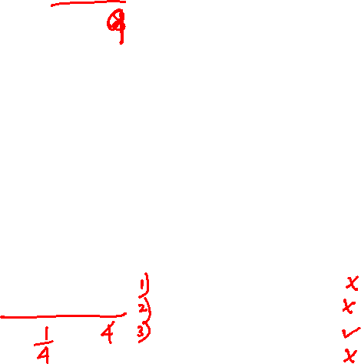
Over fitting
Shape | Colour | Size | Action
Round | Green | Small | Reject
Square | Black | Big | Allow
Square | Brown | Big | Allow
Round | Brown | Small | Reject
Square | Green | Big | Allow
Square | Brown | Small | Reject
Oval | Green | Big | Reject
Oval | Brown | Small | Allow
Oval | Green | Small | Reject
  ID3
Training Set
Shape
Assumed over fit model
Square
Oval
Round
Size
Colour
Big
Small
Green
Brown
Allow
Reject
Reject
Allow
Colour
Green
Brown
Size
Size
Shape | Colour | Size | Action
Oval | Black | Small | Reject
Round | Brown | Big | Allow
Square | Brown | Big | Allow
Oval | Green | Small | Allow
Small
Validation/Test Set
Reject
Reject

Slide 13
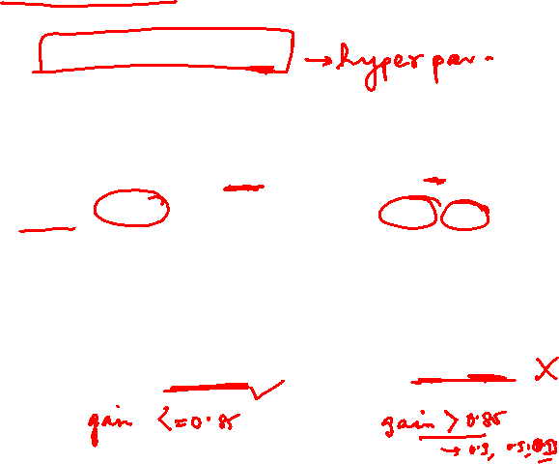
Pre-Pruning – Problem Type 7
Shape | Colour | Size | Action
Round | Green | Small | Reject
Square | Black | Big | Allow
Square | Brown | Big | Allow
Round | Brown | Small | Reject
Square | Green | Big | Allow
Square | Brown | Small | Reject
Oval | Green | Big | Reject
Oval | Brown | Small | Allow
Oval | Green | Small | Reject
  Threshold: Gain <=0.85
  Gain =0.8113 Gain =0.9182
  Idea : While construction Prune the nodes whose gain is greater than the predefined threshold
Shape
Round
Square
Oval
Reject
Colour | Size | Action
Black | Big | Allow
Brown | Big | Allow
Green | Big | Allow
Brown | Small | Reject
Colour | Size | Action
Green | Big | Reject
Brown | Small | Allow
Green | Small | Reject
Shape | Colour | Size | Action
Oval | Black | Small | Reject
Round | Brown | Big | Allow
Square | Brown | Big | Allow
Oval | Green | Small | Allow

Slide 14
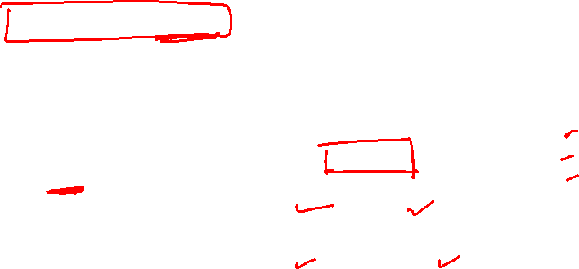
Pre-Pruning – Problem Type 7
Shape | Colour | Size | Action
Round | Green | Small | Reject
Square | Black | Big | Allow
Square | Brown | Big | Allow
Round | Brown | Small | Reject
Square | Green | Big | Allow
Square | Brown | Small | Reject
Oval | Green | Big | Reject
Oval | Brown | Small | Allow
Oval | Green | Small | Reject
  Threshold: Gain <=0.85
Shape
Round
Square
Oval
Reject
Colour | Size | Action
Black | Big | Allow
Brown | Big | Allow
Green | Big | Allow
Brown | Small | Reject
Colour
Green
Brown
Reject
Allow
Shape | Colour | Size | Action
Oval | Black | Small | Reject
Round | Brown | Big | Allow
Square | Brown | Big | Allow
Oval | Green | Small | Allow
Note:
DT can estimate the probability of instance’s
membership to a class

Slide 15
Pre-Pruning – Problem Type 7
Shape | Colour | Size | Action
Round | Green | Small | Reject
Square | Black | Big | Allow
Square | Brown | Big | Allow
Round | Brown | Small | Reject
Square | Green | Big | Allow
Square | Brown | Small | Reject
Oval | Green | Big | Reject
Oval | Brown | Small | Allow
Oval | Green | Small | Reject
  Threshold: Gain <=0.85
  Apply majority voting for converting the pruned subset of data into a class
Shape
Round
Square
Oval
Reject
Allow
Colour
Green
Brown
Reject
Allow
Shape | Colour | Size | Action
Oval | Black | Small | Reject
Round | Brown | Big | Allow
Square | Brown | Big | Allow
Oval | Green | Small | Allow

Slide 16
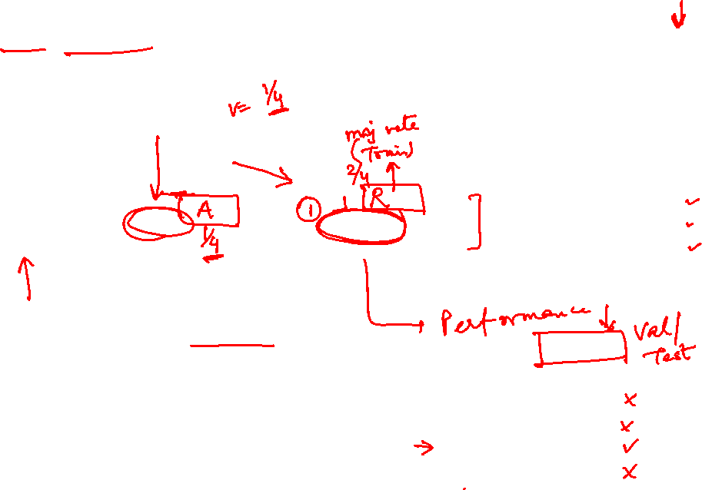
Post-Pruning – Problem Type 8
Shape | Colour | Size | Action
Round | Green | Small | Reject
Square | Black | Big | Allow
Square | Brown | Big | Allow
Round | Brown | Small | Reject
Square | Green | Big | Allow
Square | Brown | Small | Reject
Oval | Green | Big | Reject
Oval | Brown | Small | Allow
Oval | Green | Small | Reject
Assumed model from the output of one intermediate iteration of the decision tree building
Shape
Round
Square
Oval
Reject
Size
Colour
Big
Small
Green
Brown
Allow
Reject
Reject
Allow
  Idea :
  1. Post construction, scan the tree bottom-up
  2. At every decision node
  Retain the attribute node & evaluate it against the prune set (validation set)
  Remove the attribute node & reevaluate it with the same prune set
  If there is a reduction in error, prune the node else retain the node
  3. Repeat this in other branches of the tree
Prune Set
Shape | Colour | Size | Action
Oval | Black | Small | Reject
Round | Brown | Big | Allow
Square | Brown | Big | Allow
Oval | Green | Small | Allow

Slide 17
Post-Pruning – Problem Type 8
Shape | Colour | Size | Action
Round | Green | Small | Reject
Square | Black | Big | Allow
Square | Brown | Big | Allow
Round | Brown | Small | Reject
Square | Green | Big | Allow
Square | Brown | Small | Reject
Oval | Green | Big | Reject
Oval | Brown | Small | Allow
Oval | Green | Small | Reject
Assumed model from the output of one intermediate iteration of the decision tree building
  Error rate is the percentage of tuples misclassified
  Prune set is used to estimate the cost
Shape
Round
Square
Oval
Reject
Size
Colour
Big
Small
Green
Brown
Allow
Reject
Reject
Allow
Shape | Colour | Size | Action
Oval | Black | Small | Reject
Round | Brown | Big | Allow
Square | Brown | Big | Allow
Oval | Green | Small | Allow
Prune Set🡪

Slide 18
Post-Pruning – Problem Type 8
Shape | Colour | Size | Action
Round | Green | Small | Reject
Square | Black | Big | Allow
Square | Brown | Big | Allow
Round | Brown | Small | Reject
Square | Green | Big | Allow
Square | Brown | Small | Reject
Oval | Green | Big | Reject
Oval | Brown | Small | Allow
Oval | Green | Small | Reject
Shape
Round
Square
Oval
Reject
Size
Colour
Big
Small
Green
Brown/Others
Allow
Reject
Reject
Allow
Prune Size &Predict | Prune Colour & Predict | Above Tree’s Prediction | Shape | Colour | Size | Action
Allow | Reject | Allow | Oval | Black | Small | Reject
Reject | Reject | Reject | Round | Brown | Big | Allow
Allow | Allow | Allow | Square | Brown | Big | Allow
Reject | Reject | Reject | Oval | Green | Small | Allow

Slide 19

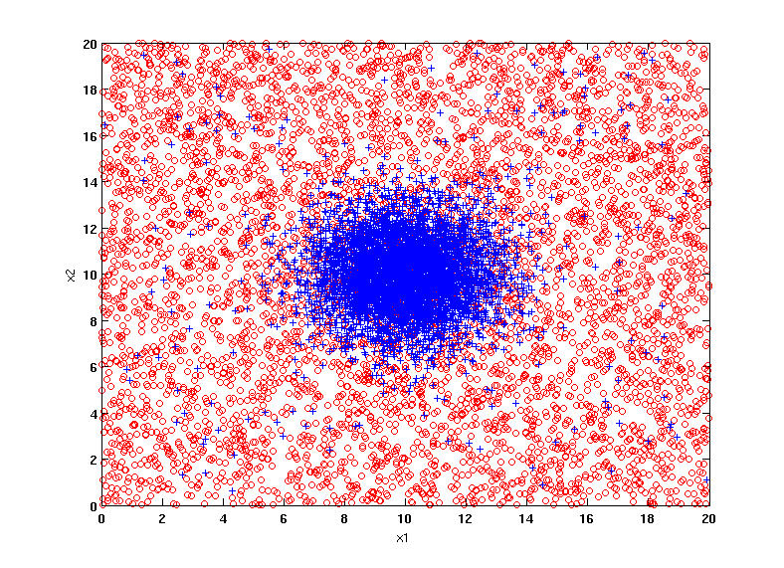
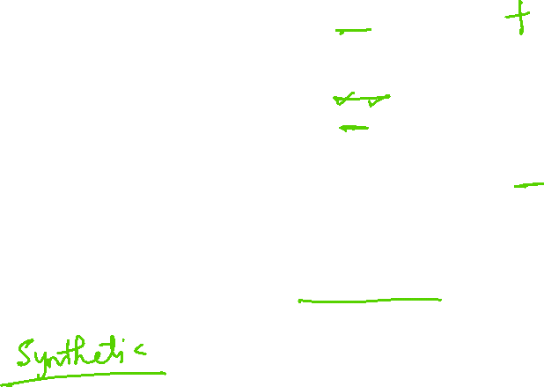
Example Data Set
Studying Overfitting & Bias–Variance Tradeoff
Two class problem:
+ : 5200 instances
5000 instances generated from a Gaussian centered at (10,10)
200 noisy instances added
o : 5200 instances
Generated from a uniform distribution
10 % of the data used for training and 90% of the data used for testing
BITS Pilani, Deemed to be University under Section 3 of UGC Act, 1956

Slide 20
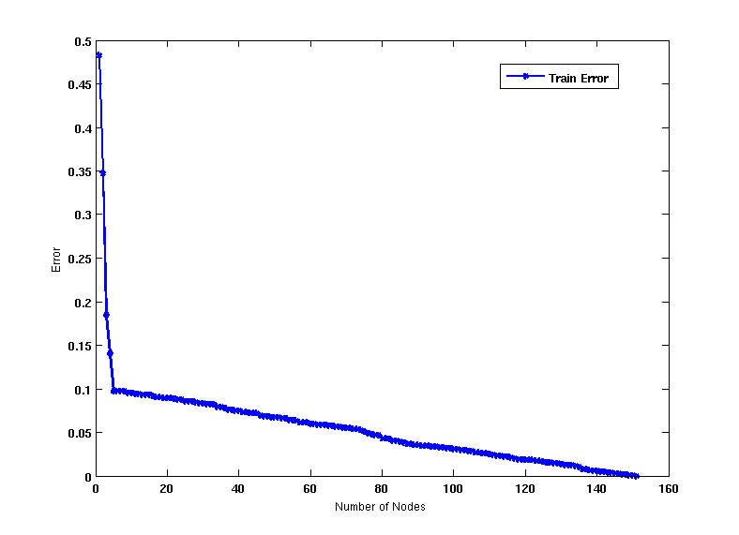
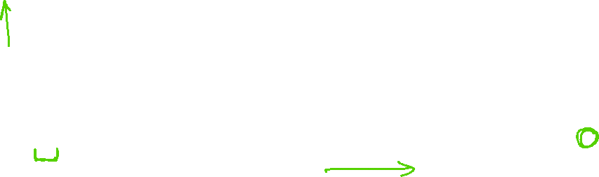
Increasing number of nodes in Decision Trees
BITS Pilani, Deemed to be University under Section 3 of UGC Act, 1956

Slide 21
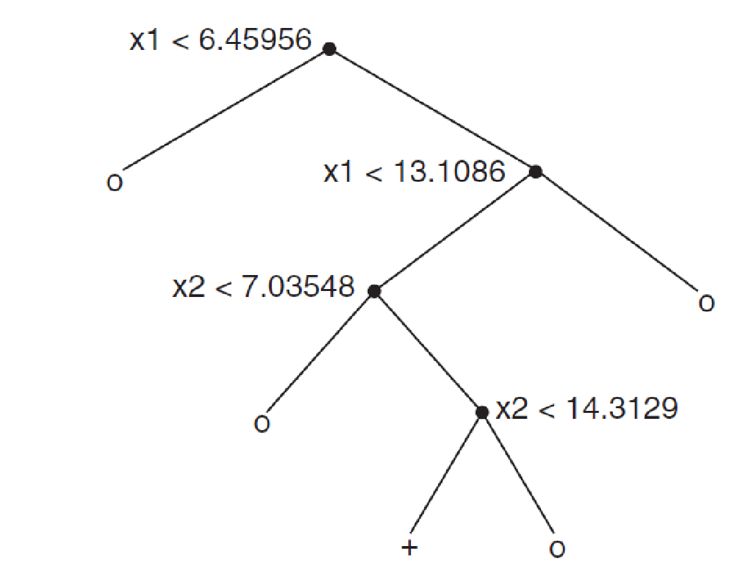
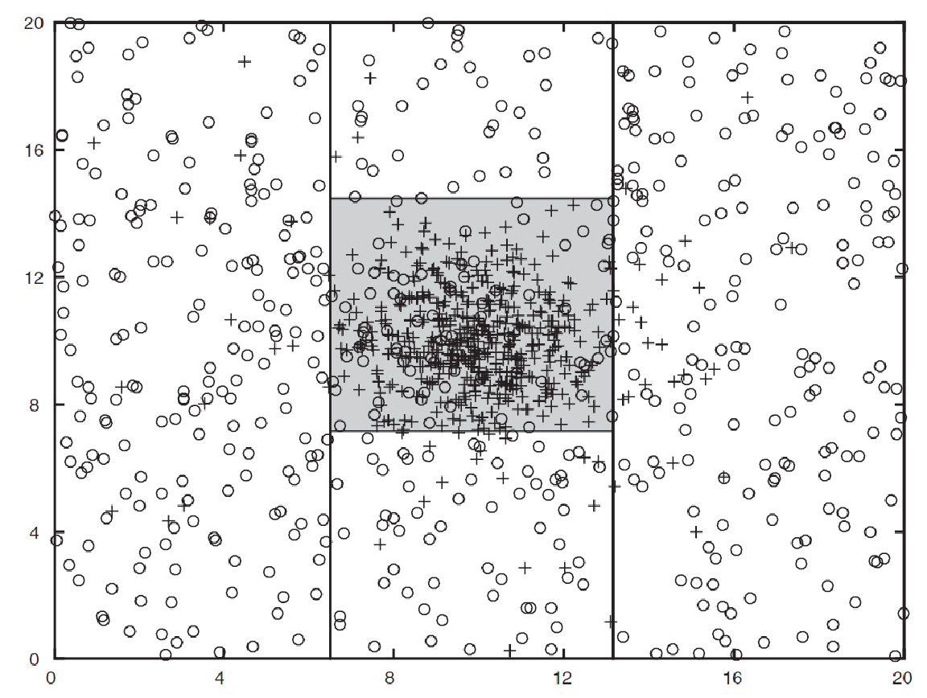
Decision Tree with 4 nodes
Decision Tree
Decision boundaries on Training data
BITS Pilani, Deemed to be University under Section 3 of UGC Act, 1956

Slide 22
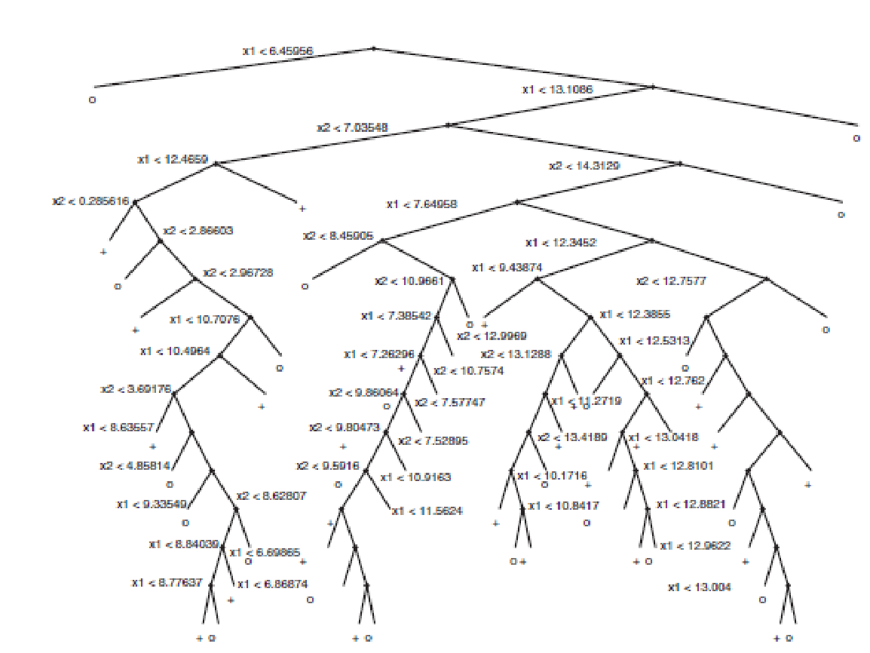
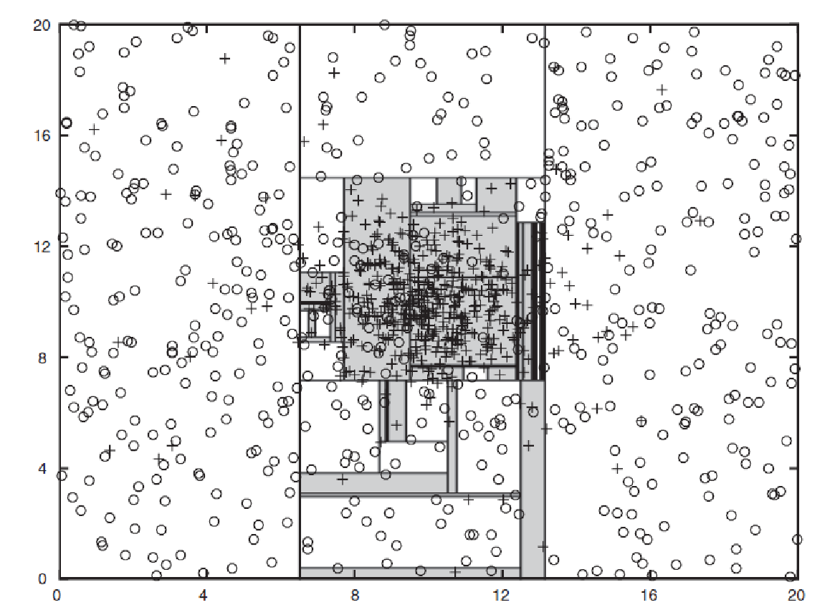

Decision Tree with 50 nodes
Decision Tree
Decision Tree
Decision boundaries on Training data
BITS Pilani, Deemed to be University under Section 3 of UGC Act, 1956

Slide 23
Which tree is better?
Problem Type 9 – Model Comparison
Decision Tree with 4 nodes
Which tree is better ?
Decision Tree with 50 nodes
BITS Pilani, Deemed to be University under Section 3 of UGC Act, 1956

Slide 24
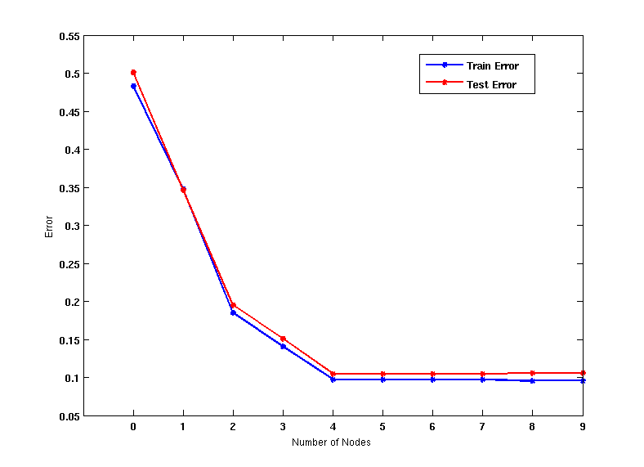
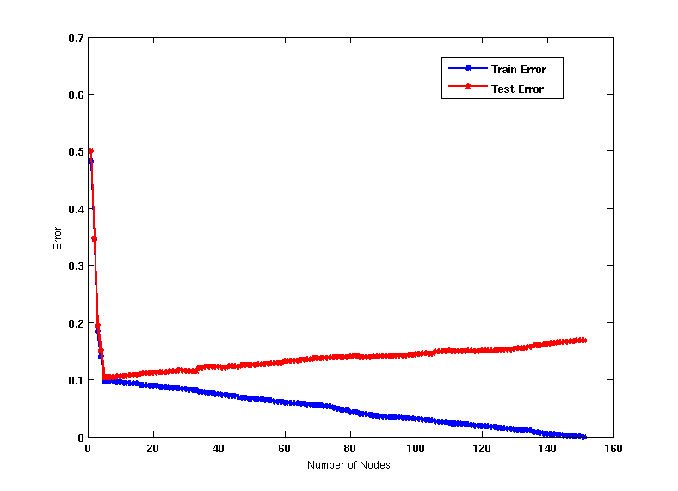

Model Overfitting
Underfitting: when model is too simple, both training and test errors are large
Overfitting: when model is too complex, training error is small but test error is large
BITS Pilani, Deemed to be University under Section 3 of UGC Act, 1956

Slide 25
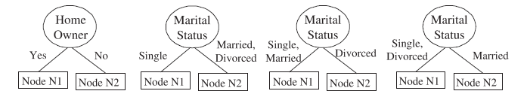
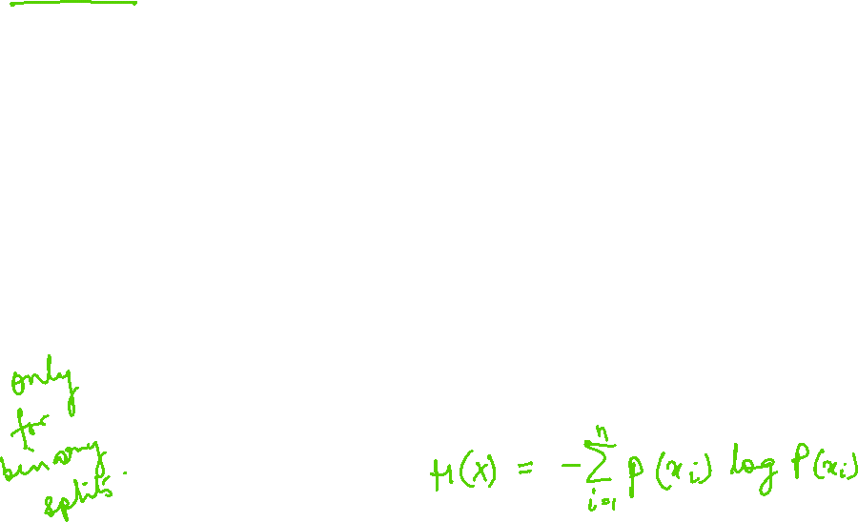
Alternative to Entropy:
Gini Index : Binary Splits

Slide 26
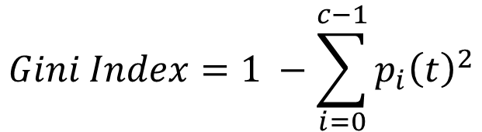

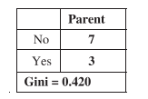
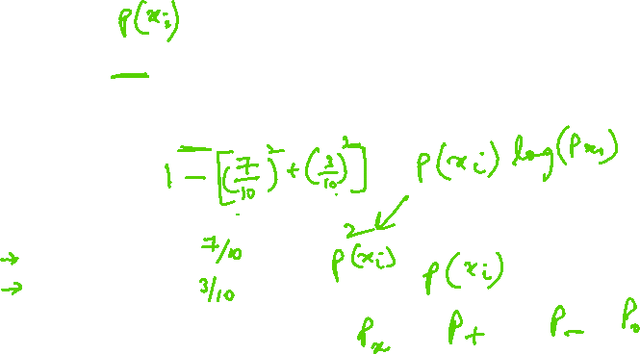
Alternative to Entropy:
Gini Index : Binary Splits
Gini Index:Parent

Slide 27
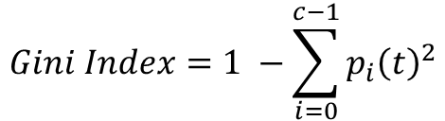
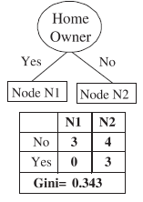


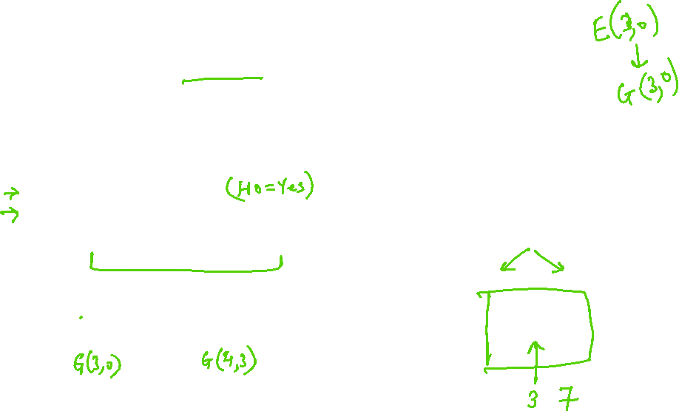
Alternative to Entropy:
Gini Index : Binary Splits
Splitting Attribute: HomeOwner
Gini index for the child nodes
N1 = 1- (0/3)² - (3/3)² = 0
N2 =1- (3/7)² - (4/7)² = 0.490
Weighted Gini Index for children
The gain using Home Owner as splitting attribute is
0.420 - 0.343 =0.077

Slide 28
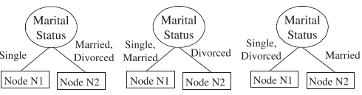
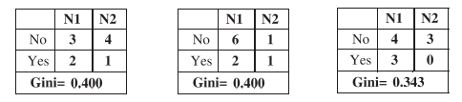
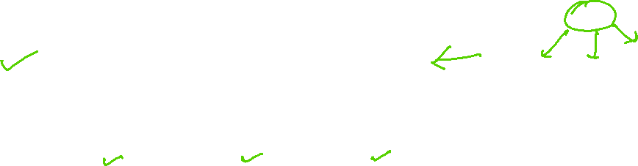
Alternative to Entropy:
Gini Index : Binary Splits
Splitting Attribute: MaritalStatus
Based on these results, Home Owner and the last binary split using Marital Status are clearly the best candidates, since they both produce the lowest weighted average Gini index

Slide 29
An alternative measure: gain ratio
    c |S_{i} | |S_{i} |
SplitInformation(S, A) ≡ − Σ log₂ i=1 |S | |S |
S_{i} are the sets obtained by partitioning on value i of A
SplitInformation measures the entropy of S with respect to the values of A. The more uniformly dispersed the data the higher it is.
Gain(S, A)
GainRatio(S, A) ≡
SplitInformation(S, A)
GainRatio penalizes attributes that split examples in many small classes such as Date. Let |S |=n, Date splits examples in n classes
  SplitInformation(S, Date)= −[(1/n log₂ 1/n)+…+ (1/n log₂ 1/n)]= −log₂1/n =log₂n
Compare with A, which splits data in two even classes:
  SplitInformation(S, A)= − [(1/2 log₂1/2)+ (1/2 log₂1/2) ]= − [− 1/2 −1/2]=1
Notes:
2^{-x} = 1/2^{x}

Slide 30
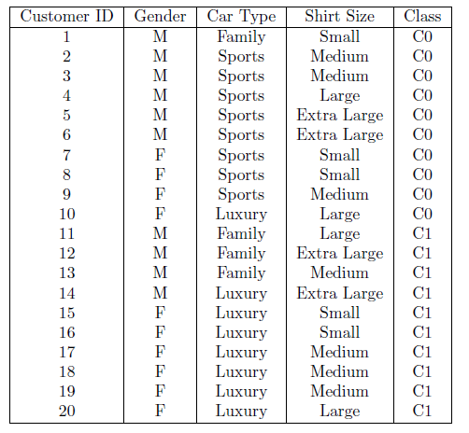
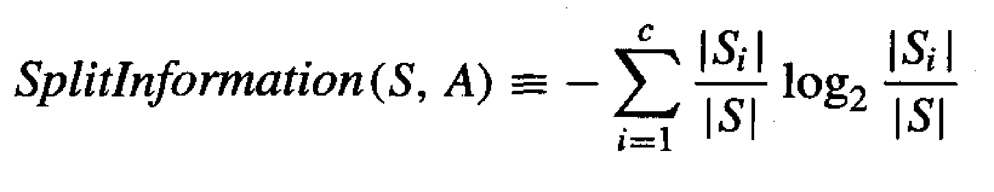
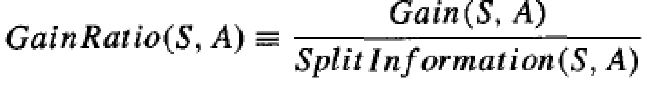
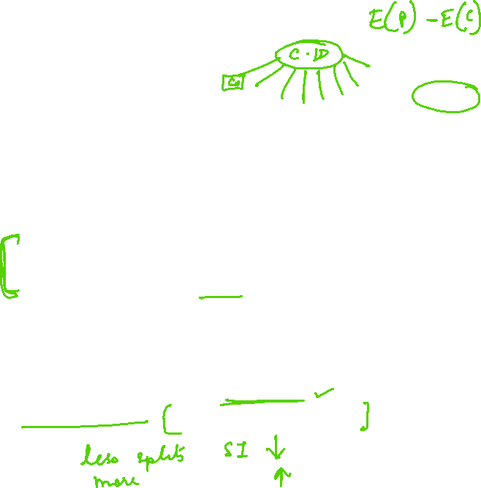
Limitation of Information Gain:
Ways to tackle
SplitInformation measures the entropy of S with respect to the values of A. The more uniformly dispersed the data the higher it is.
GainRatio penalizes attributes that split examples in many small classes such as ID by incorporating split information.
  SplitInformation(S, customerID)= −[(1/n log₂ 1/n)+…+ (1/n log₂ 1/n)]= −log₂1/n =log₂n
Select the best attribute test condition among the
following three attributes: Gender, Car Type, and Customer ID

Slide 31
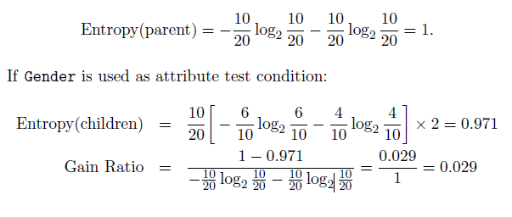
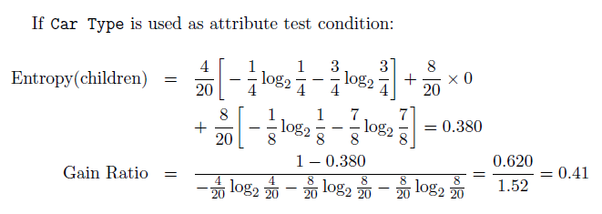
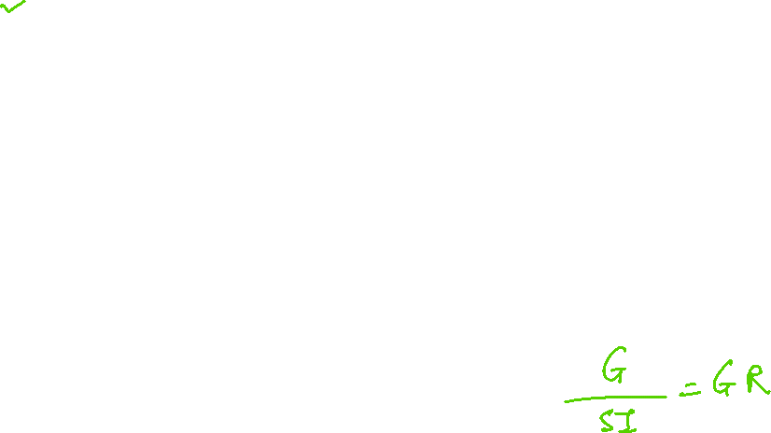
Limitation of Information Gain:
Ways to tackle
Problem Type 10

Slide 32
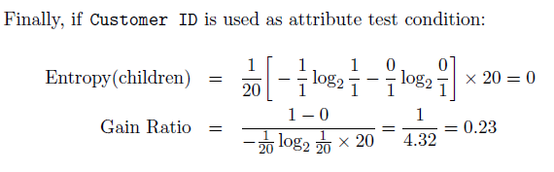
Limitation of Information Gain:
Ways to tackle
Problem Type 10
Inference : Thus, even though Customer ID has the highest information gain, its gain ratio is lower than Car Type since it produces a larger number of splits

Slide 33
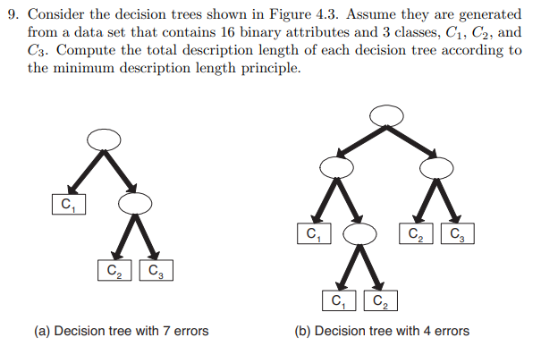

Minimum Description Length Principle
Problem Type 11

Slide 34


Minimum Description Length Principle
Problem Type 11

Slide 35


Minimum Description Length Principle
Interesting fact from information theory:
  The optimal (shortest expected coding length) code for an event with
  probability p is –log₂p bits.
So interpret (1):
L_{C1}(h) = length(h) = –log₂P(h) [cost to encode the model]
L_{C2}(D|h)= length(misclassifications) = –log₂P(D|h) [cost to encode the data errors given the model]
→ prefer the hypothesis that minimizes
length(h) + length(misclassifications)

Slide 36
Minimum Description Length Principle
MDL principle provides a way of trading off hypothesis complexity for the number of errors committed by the hypothesis.
May select a shorter hypothesis that makes a few errors over a longer hypothesis that perfectly classifies the training data.
Provides one method for dealing with the issue of overfitting the data.

Slide 37

Minimum Description Length Principle
Occam’s razor: prefer the shortest hypothesis
MDL: prefer the hypothesis h that minimizes
where L_{C}(x) is the description length of x under encoding C
Example: H = decision trees hypothesis, D = training data labels
L_{C1}(h) is # bits to describe tree h
L_{C2}(D|h) is # bits to describe D given h
  Note L_{C2}(D|h) = 0 if examples classified perfectly by h. Need only describe exceptions
Hence h_{MDL} trades off tree size for training errors

Slide 38

Practice Exercises (for Students)

Slide 39
Additional References
Decision Tree
https://www.youtube.com/watch?v=eKD5gxPPeY0&list=PLBv09BD7ez_4temBw7vLA19p3tdQH6FYO&index=1
Overfitting
https://www.youtube.com/watch?time_continue=1&v=t56Nid85Thg
https://www.youtube.com/watch?v=y6SpA2Wuyt8
Random Forest
https://www.stat.berkeley.edu/~breiman/RandomForests/

Slide 40
Thank you !

